Slide 1
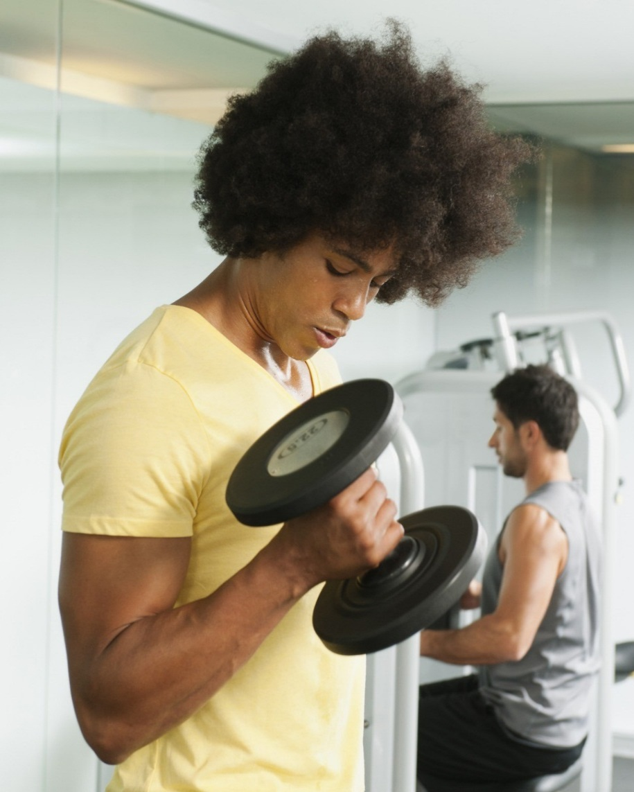


Leisure Services Department
Plan for returning to play

Slide 2
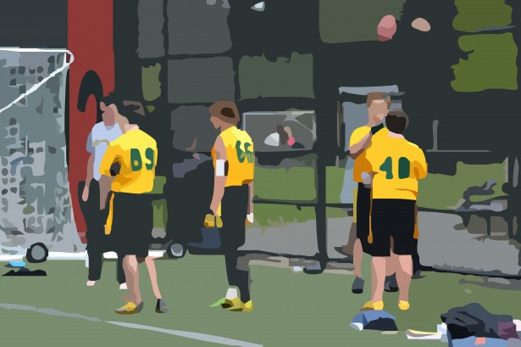
Arrival to games and events
Mandatory
All participants, spectators, and employees must adhere to six-foot physical distancing while at the facility/course.
Must conduct daily symptom assessments by coaches and players (self-evaluations). Anyone experiencing symptoms must stay home. (High fever, coughing, runny nose, trouble breathing, etc.)
No team water coolers or shared drinking stations.
Compliant game balls must be designated to each team for use while that team is playing defense.
Prior to competitive tournaments, events owners must alert the local health department of the events.
These requirements must be shared prior to the event with all players, coaches, spectators, officials and employees prior to their arrival at the venue.
Recommended
Digital check-in when available and registration for all events and programs.
Lineups should be entered online or by spoken word and recorded by officials/umpires without exchanging any physical documents with coaches or players.
Athletes are strongly recommended to travel to the venue with a member of their immediate household.

Slide 3


AT PRACTICEs
MANDATORY
Coaches and players must adhere to physical six-foot distancing except when the ball is in PLAY.
Coaches must always wear face coverings .
Athletes must always wear face coverings while not actively participating in the field of play.
Must conduct daily symptom assessments by coaches and players (self-evaluation). Temperature checks.
Anyone experiencing symptoms must stay home and cannot practice.
No team water coolers or shared drinking stations/bottles etc.…
RECOMMENDED
Face coverings are strongly recommended for any spectators.
For each practice session, it is recommended that coaches divide players into groups and establish rotating shifts when possible.
Athletes should bring individual waste containers.
Virtual meeting should be considered when possible.
Athletes are strongly recommended to travel to the venue with a member of their immediate household, if possible.
Face coverings are strongly recommended for individuals traveling to and from the venue.
Whenever possible, equipment and personal items should have proper separation and should not be shared. If equipment must be shared, proper sanitation should be administered between users.

Slide 4
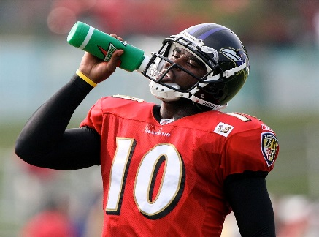

ATHLETES AND PARTICIPANTS
MANDATORY
All participants, spectators, and employees must adhere to six-foot physical distancing while at the facility/course.
Must conduct daily symptom assessments (Check lists) by coaches and players. Also daily self-evaluations. Anyone experiencing symptoms must stay home. (High fever, coughing, runny nose, trouble breathing, etc.)
No team water coolers or shared drinking stations.
Compliant game balls must be designated to each team for use while that team is playing defense.
Prior to competitive tournaments, events owners must alert the local health department of the events.
These requirements must be shared prior to the event with all players, coaches, spectators, officials and employees prior to their arrival at the venue.
Please refrain from high fives, hand shaking, hugging, our touching any teammate, coach, player, parents, etc.
Recommended
Digital check-in when available and registration for all events and programs.
Line ups should be entered online or by spoken word and recorded by officials/umpires without exchanging any physical documents with coaches or players.
Athletes are strongly recommended to travel to the venue with a member of their immediate household.
Continued washing hands or using hand sanitizer.

Slide 5

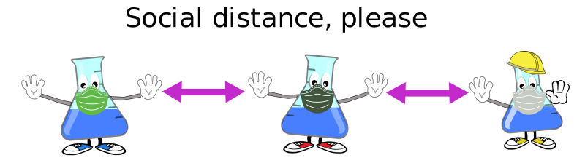
SPECTATORS (PARENTS ETC.)
Mandatory
Must adhere to six-foot social distancing practices. This includes in and around bleachers for anyone not in the same family.
Must conduct daily symptom assessments (self-evaluations). Anyone experiencing symptoms must stay home.
Must keep six-feet or more distance from the backstop or playing areas.
RECOMMENDED
Strongly always recommended to ware face coverings .
Hand washing or hand sanitizing, in the absence of soap and water, is strongly recommended during the games.

Slide 6

MANDATORY
Must adhere to six-foot social distancing practices.
Must always war face coverings .
Must conduct daily symptom assessments by coaches and players (self evaluation) anyone experiencing symptoms must stay home.
No spitting or eating seeds, gum, or other similar products while coaching.
No touch rule- coaches should refrain from high fives, handshakes lines, and other physical contact with teammates, apposing players coaches, umpires and fans. A “tip the cap” can be used following the game in Liew of the handshake line.
Must ensure that players are following covid-19 related prevention measures included herein.
Recommended
COACHES SHOULD ENSURE THE PLAYERS ARE ADHERING TO SOCIAL DISTANCING IN DUGOUTS AND OTHER SEATING AREAS AS WELL AS WEARING FACE COVERINGS WHILE NOT ACTIVELY PARTICIPATING ON THE FIELD OF PLAY.
WHENEVER POSSIBLE, EQUIPMENT AND PERSONAL ITEMS SHOULD HAVE PROPER SEPARATION AND SHOULD NOT BE SHARED. IF EQUIPMENT MUST BE SHARED COACHES MUST MAKE SURE PROPER SANITATION SHOULD BE ADMINISTERED BETWEEN USERS.
This Photo by Unknown Author is licensed under CC BY-SA

Slide 7
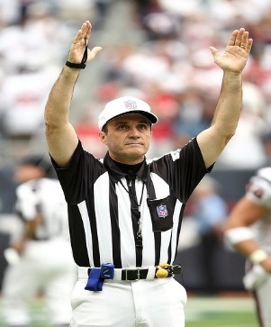
UMPIRES/OFFICIALS
MANDATORY
Must adhere to six-foot social distancing practices. This includes in and around bleachers for anyone not in the same family.
Must conduct daily symptom assessments (self-evaluations). Anyone experiencing symptoms must stay home. Have home team conduct temperature check and fill out check off list on each.
MUST WEAR FACE COVERINGS AT ALL TIMES.
MUST AVOID EXCHANGING DOCUMENTS OR EQUIPMENT WITH PLAYERS, COACHES, OR SPECTATORS.
RECOMMENDED
DIGITAL CHECK IN AND REGISTRATION FOR ALL EVENTS.
UMPIRES CALLING BALLS AND STRIKES SHOULD ALLOW ADEQUATE DISTANCE BEHIND THE Catcher/players WHILE STILL ABLE TO PERFORM THEIR DUTY.

Slide 8

WHEN LEAVING THE GAME OR VENUE
MANDATORY
Individuals should not congregate in common areas or parking lots following the event, game or practice.
Umpires should adhere to social distancing practices when interacting with players coaches and spectators off the fields of play.
Individuals should not exchange items.
RECOMMENDED
Team meeting should occur virtually or over the phone rather than in a team huddle.
Athletes are strongly recommended to travel to the venue with a member(s) of their immediate household, if possible.
Face coverings are strongly recommended for individuals traveling to and from the venue.

Slide 9

What to do if we have a confirmed positive covid-19 case
MANDATORY
Immediately isolate and seek medical care for any individual who develops symptoms.
Contact the local health district about the suspected cases or exposures.
Organizer must maintain a complete list of coaches, players, and employees present at each event to include the date, beginning and ending time of the event, plus name address and phone contact to be made available upon request from local health district.
RECOMMENDED
Work with local health departments to identify potentially infected or exposed individuals to help facilitate effective contact tracing/notification.
Test all suspected infections or exposures.
Following testing, contact local health departments to initiate appropriate care and tracing.

